Slide 1
CAPSTONE PROJECT Automated Retail Analytics using Google Cloud Services
TEAM -
KUMAR PRATYUSH
SRUTHIKA
MURAKUNDLA PRASAD
VARUN MAYANDI

Slide 2
Business Problem Statement
The retail operations team receives transactional data throughout the day from multiple source systems, including customer management, order processing, product catalog, and payment systems. This data arrives as raw CSV files in cloud storage, often containing duplicate records, inconsistent formats, missing values, and unstandardized codes.
Traditional reporting approaches are unable to:
Reliably ingest and process daily batch files in a structured manner
Handle duplicate records and inconsistent customer or product information
Maintain historical tracking of customer attribute changes
Provide a trusted, analytics-ready data model for business reporting
Deliver consistent and timely insights into sales performance and customer behavior
As a result, business teams lack a centralized and governed analytics system to monitor revenue trends, customer value, and product performance. Data inconsistencies lead to conflicting KPIs across departments, delayed reporting cycles, and unreliable decision-making.

Slide 3
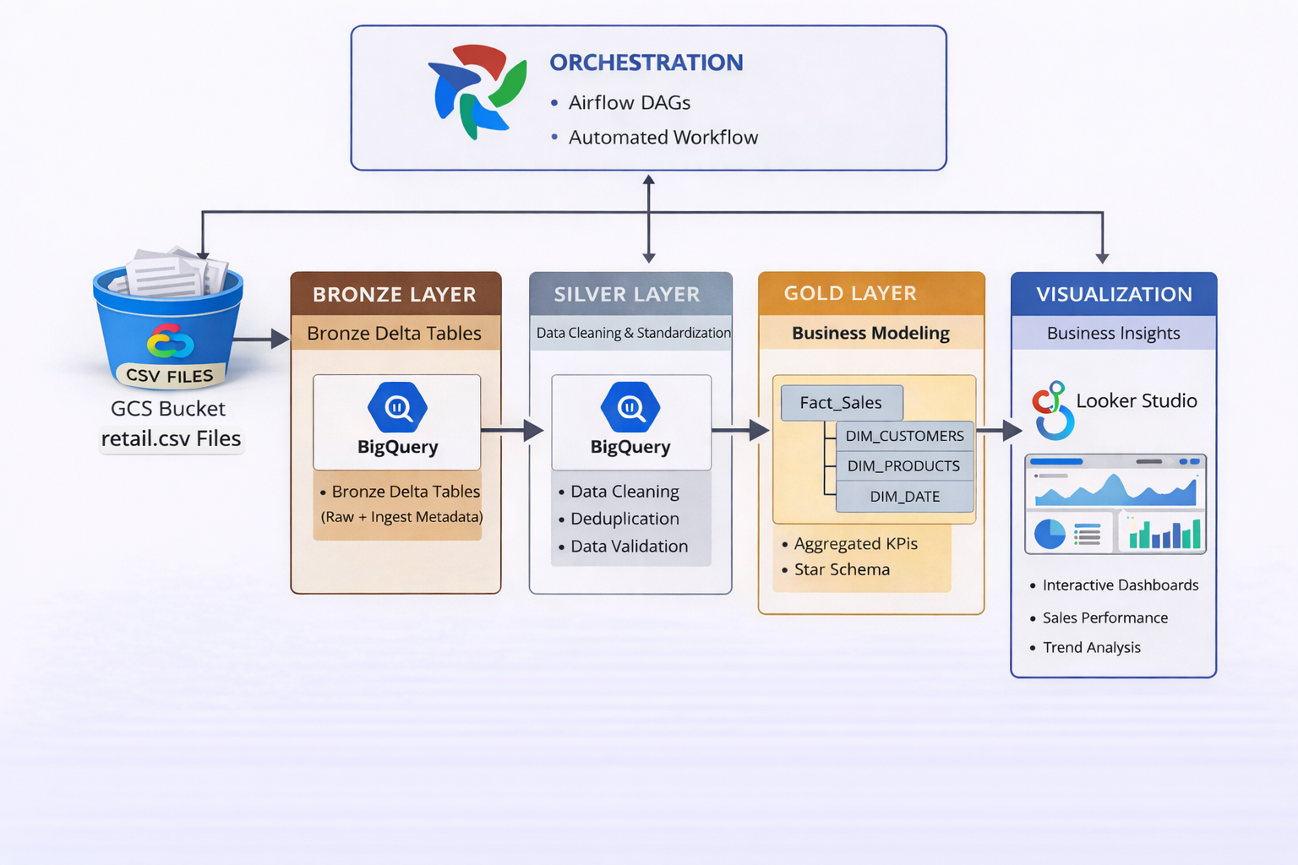
ARCHITECTURE

Slide 4
Data Quality Issues:-
Missing and null values : Present in both critical and non-critical columns.
Duplicate records : Duplicate customer_code values across batches.
Outliers : Negative and extreme payment values.
Invalid categorical values : Invalid product_codes, customer_codes, and inconsistent order_item_id
The retailer wants a Data Lakehouse solution to:
Ingest batch data and store in some fully managed storage.
Clean and standardize data into Silver
Create Gold star schema for analytics
Compute operational KPIs and delay/cancellation trends
Detect anomalies like delay spikes and airport congestion patterns
Serve Looker Dashboards connected to BigQuery datasets.

Slide 5
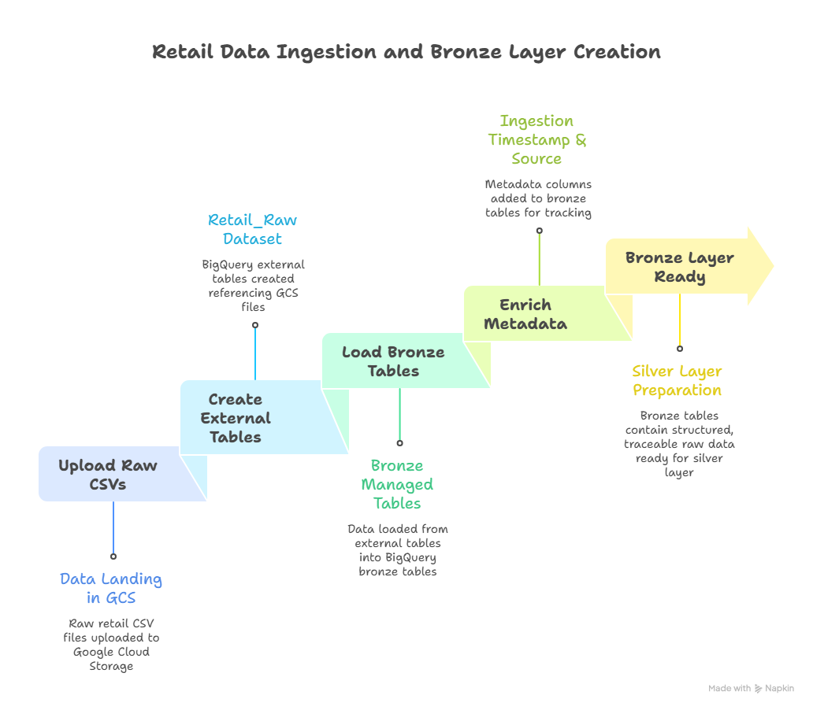
BRONZE LAYER
DAY 1

Slide 6
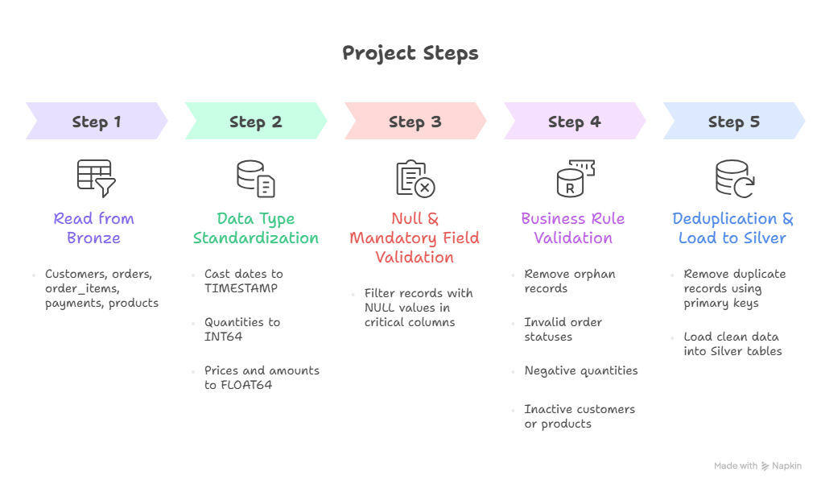
SILVER LAYER

Slide 7
GOLD LAYER
1. Designed and built dimension tables:
dim_customers
dim_products
dim_date
2. Built Gold fact table:
gold.fact_sales by joining the latest Silver transactional data (orders, order_items, payments) with all dimension tables.
3.Implemented KPI feature engineering using SQL:
Total Revenue
Total Orders
Total Quantity Sold
Average Order Value (AOV)
Customer Lifetime Value (CLV)
Product Contribution %
Daily & Monthly Sales Trends

Slide 8
4. Built aggregated fact tables for performance optimization:
fact_daily_sales
fact_customer_sales
fact_product_sales
5. Optimized Gold tables:
Partitioned fact tables by order_date
Clustered by customer_code and product_code
Compared query performance before and after partitioning & aggregation
Validated improvements using execution details in BigQuery
Integrated Gold layer with Looker Studio for executive dashboards and KPI monitoring.

Slide 9
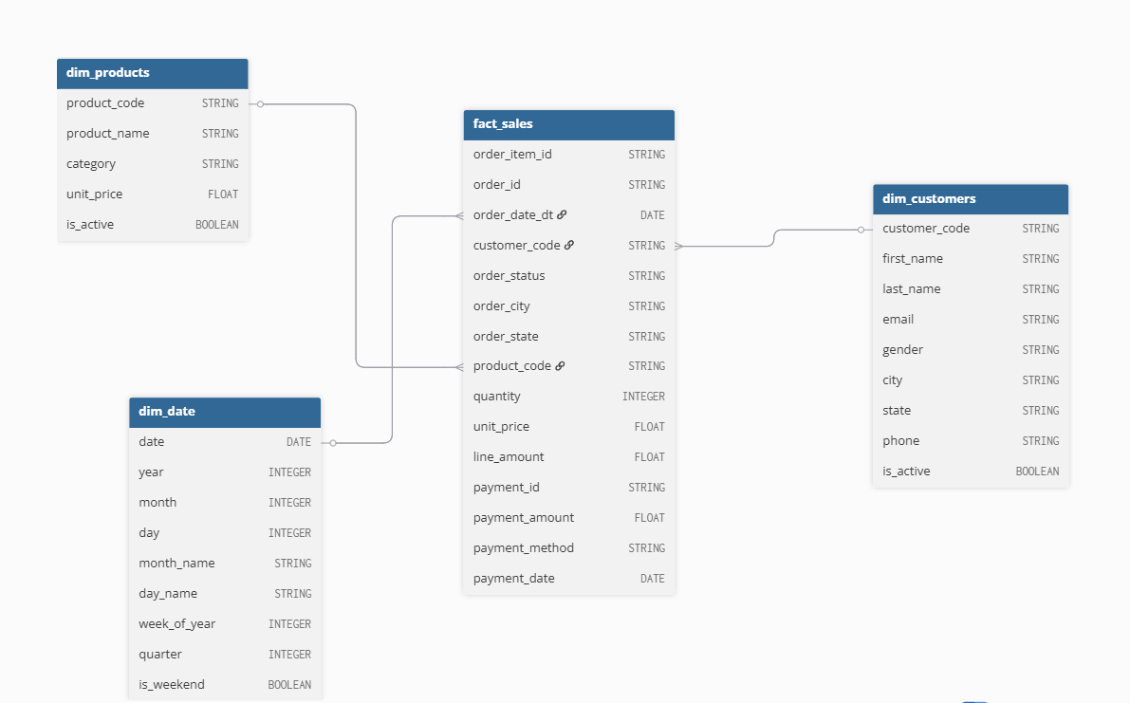

Slide 10
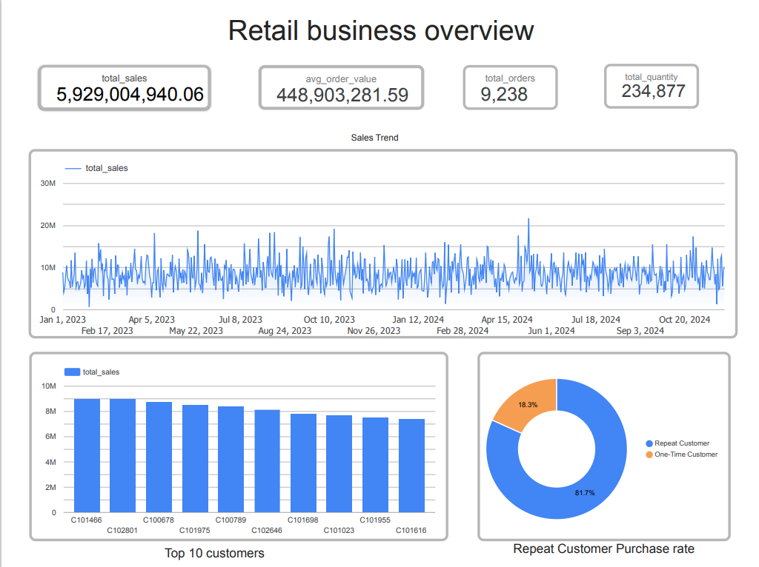
LOOKER AND DASHBOARD
Connected Looker to BigQuery Warehouse and made Looker Dashboards.

Slide 11
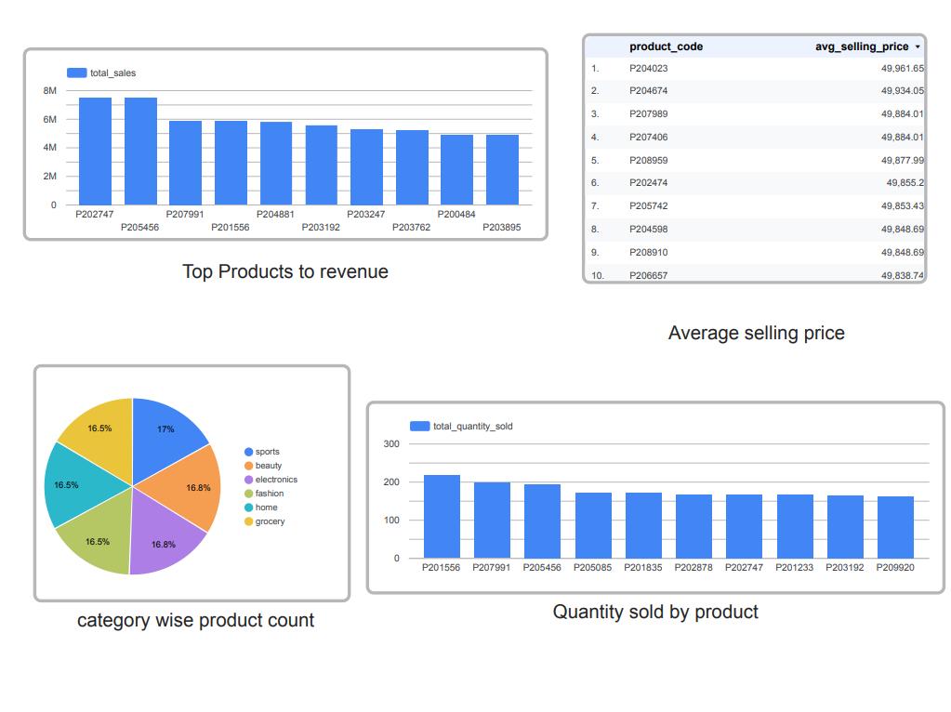

Slide 12
THANK YOU

